Slide 1

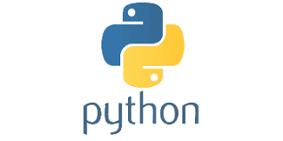
PYTHON
Lecture 1

Slide 2

Today’s Agenda
Prerequisites Of Learning Python
Necessity Of Programming
What Is Python ?
Why And Who Created It ?
What Python Can Do ?
Why Should I Learn Python In 2020 ?
Important Features
Course Outline

Slide 3
What You Should Know ?
To start learning Python , there is no strict pre-requisite
No specific programming language knowledge is needed.
Just basic knowledge in C/C++ is more than sufficient

Slide 4
Why Do We Need Programming ?
To communicate with digital machines and make them work accordingly
Today in the programming world , we have more than 900 programming languages available.
And every language is designed to fulfill a particular kind of requirement

Slide 5
Brief History Of Prog. Lang
C language was primarily designed to develop “System Softwares” like Operating Systems, Device Drivers etc .
To remove security problems with “C” language , C++ language was designed.
It is an Object Oriented Language which provides data security and can be used to solve real world problems.
Many popular softwares like Adobe Acrobat , Winamp Media Player,Internet Explorer,MS Office etc were designed in C++
Courtsey:http://www.stroustrup.com/applications.html

Slide 6
What is Python ?
Python is a general purpose and powerful programming language.
Python is considered as one of the most versatile programming language as it can be used to develop almost any kind of application including :
desktop applications
web applications
IoT applications
AI , ML and Data Science applications
and many more . . .

Slide 7
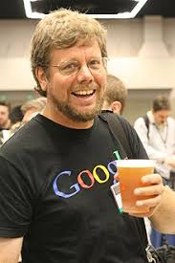
Who created Python ?
Developed by Guido van Rossum , a Dutch scientist
Created at Center For Mathematics and Research , Netherland
It is inspired by another programming language called ABC

Slide 8
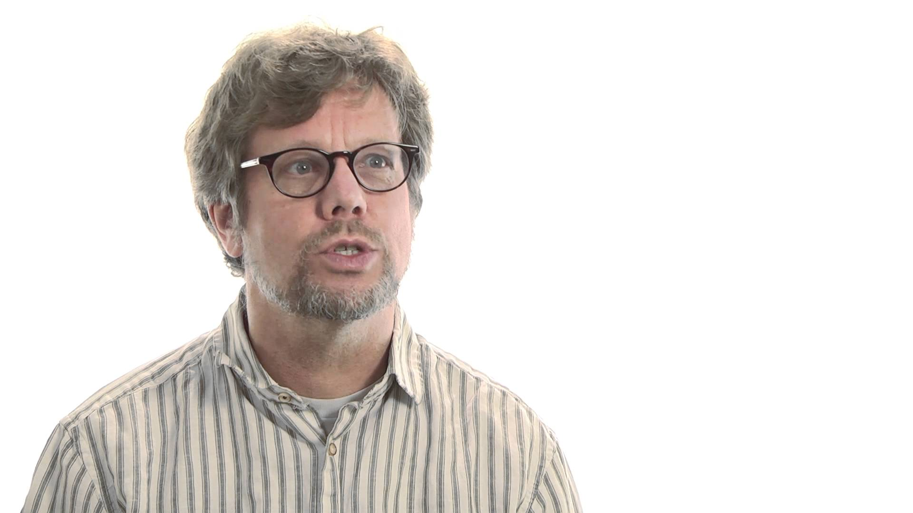
Why was Python created ?
Guido started Python development as a hobby in 1989
But since then it has grown to become one of the most polished languages of the computing world.

Slide 9
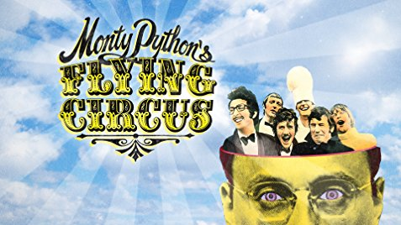
How Python got it’s name?
The name Python is inspired from Guido’s favorite Comedy TV show called “Monty Python’s Flying Circus”
Guido wanted a name that was short, unique, and slightly mysterious, so he decided to call the language Python.

Slide 10
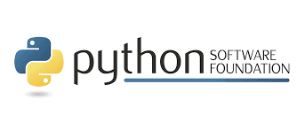
Who manages Python today ?
From version 2.1 onwards , Python is managed by Python Software Foundation situated in Delaware , USA
It is a non-profit organization devoted to the growth and enhancement of Python language
Their website is http://www.python.org

Slide 11
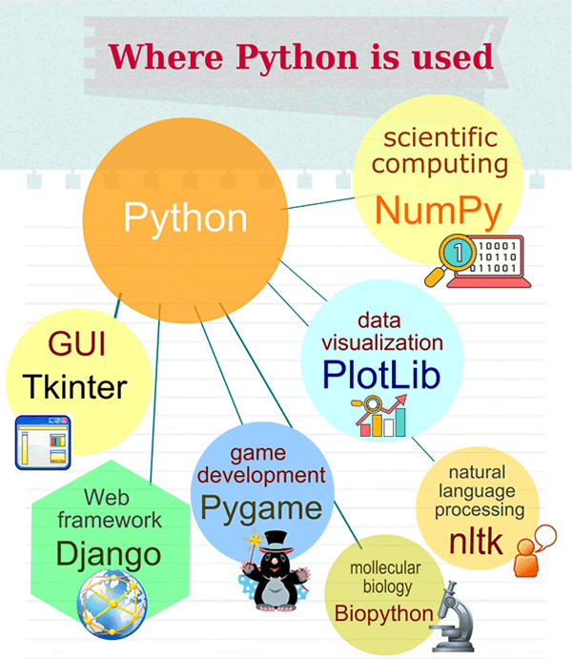
Where Is Python used ?
GUI
Web
Data Science
AI & ML
IoT
Hacking

Slide 12
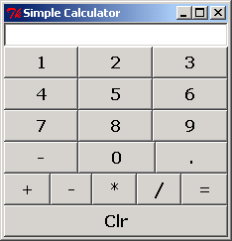
GUI In Python
Python is used for GUI apps all the time.
It has famous libraries like PyQT , Tkinter to build desktop apps.

Slide 13
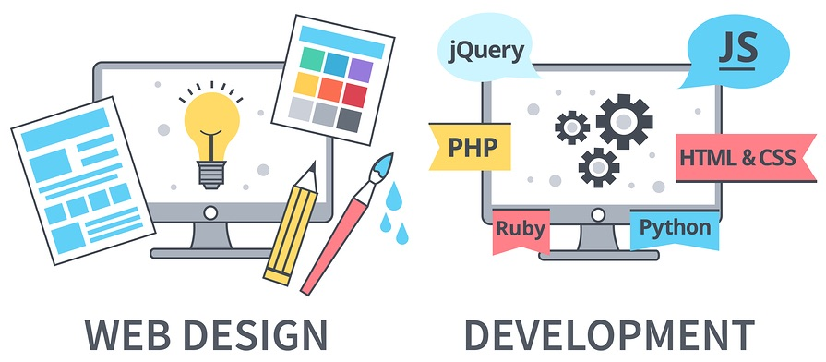
Web Application In Python
We can use Python to create web applications on many levels of complexity

Slide 14
Famous Websites Developed Using Python
There are numerous examples of popular, high-load websites/webapps that have been developed using Python.
Here are some of the most popular of them:
NASA
Instagram
Udemy
Spotify
Mozilla
Dropbox
And above all YouTube

Slide 15
Web Application In Python
There are many excellent Python frameworks like Django, Flask for web application development

Slide 16
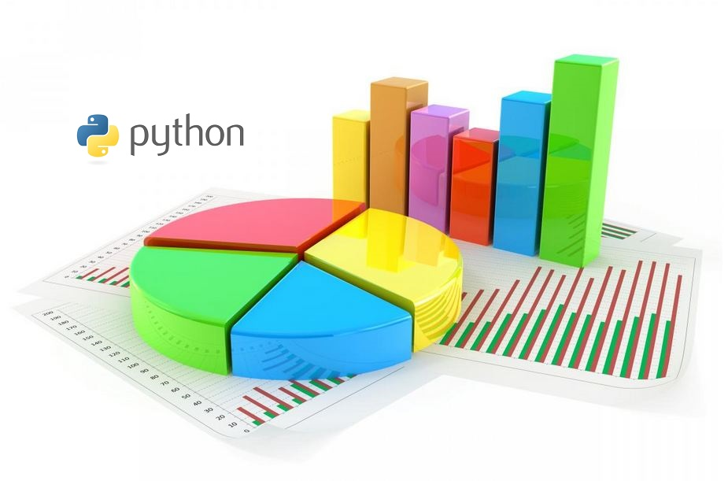
Data Science In Python
Data Science is about making predictions with data

Slide 17
Some Examples
How do you think Super Market stores decide what are the items they should club together to make a combo?
How it happens ?
Answer: Data Science

Slide 18
Some Examples
Have you noticed that every time you log on to Google, Facebook and see ads, they are based on your preferences
How it happens ?
Answer: Data Science

Slide 19
Data Science In Python
Python is the leading language of choice for many data scientists
It has grown in popularity due to it’s excellent libraries like Numpy , Pandas etc

Slide 20
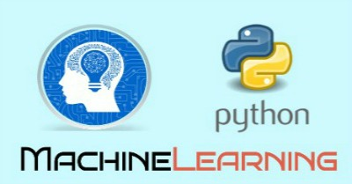
AI & ML In Python
Machine learning is a field of AI (Artificial Intelligence) by using which software applications can predict more accurate outcomes based on historical data.
It is heavily used in Face recognition , music recommendation , medical data etc

Slide 21
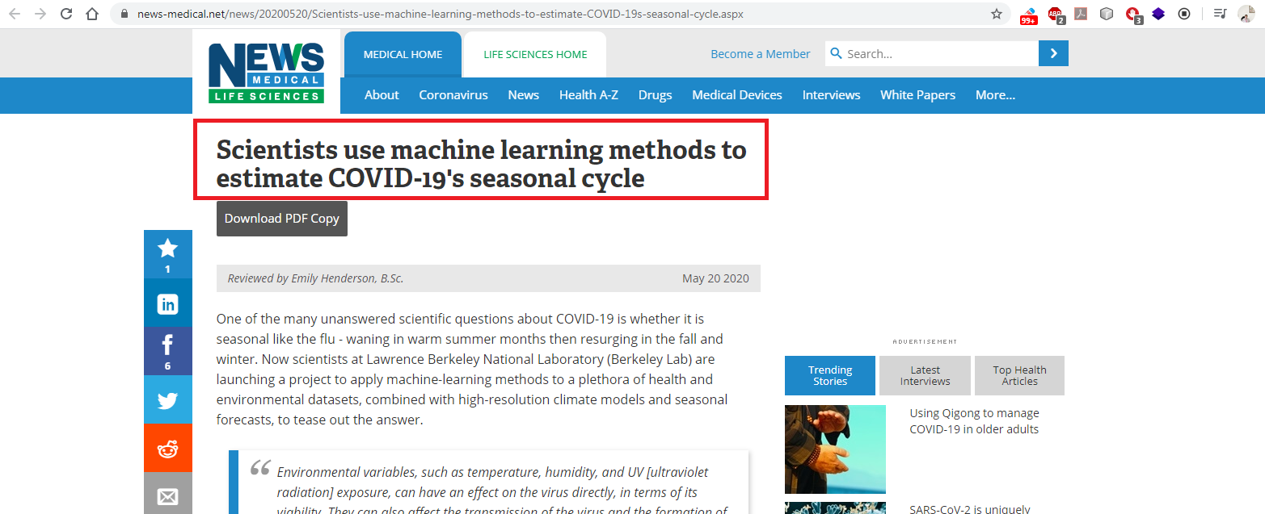
Use Of ML In COVID-19

Slide 22
AI & ML In Python
Python has many wonderful libraries to implement ML algos like SciKit-Learn , Tensorflow etc

Slide 23

IoT In Python
The Internet of Things, or IoT, refers to the billions of physical devices around the world that are now connected to the internet, all collecting and sharing data.
For example:
A lightbulb that can be switched on using a smartphone app is an IoT device

Slide 24
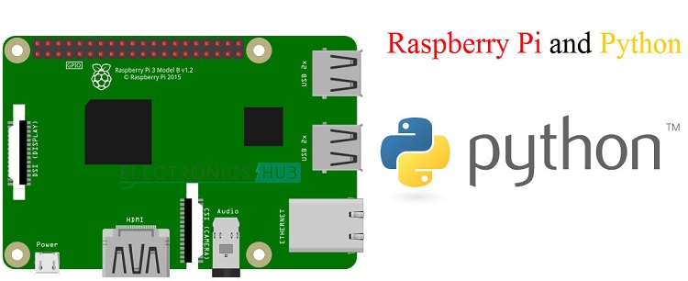
IoT In Python
We can build Home Automation System and even robots using IoT
The coding on an IoT platform like Raspberry Pi can be performed using Python

Slide 25
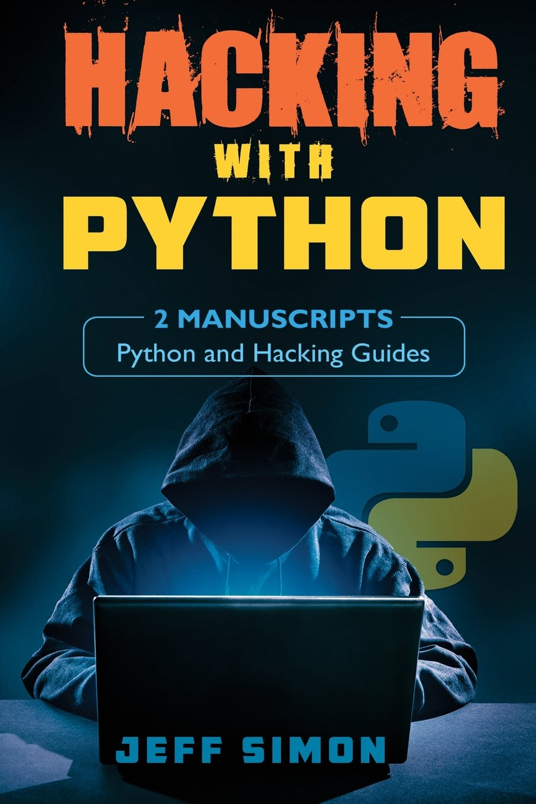
Hacking In Python
Python has gained popularity as preferred language for hacking.
Hackers generally develop small scripts and Python provides amazing performance for small programs

Slide 26
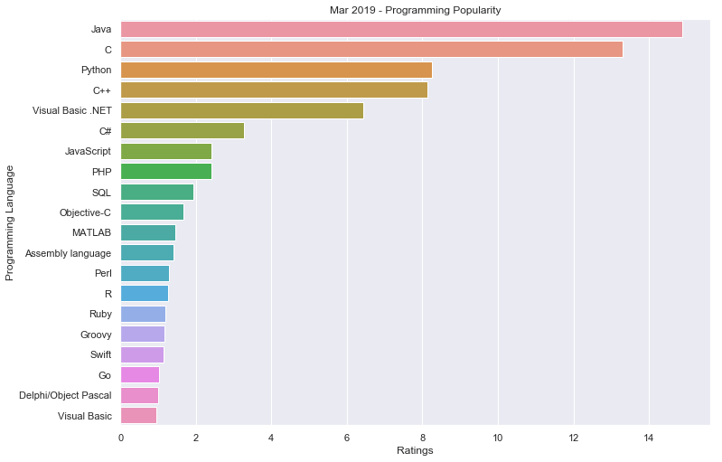
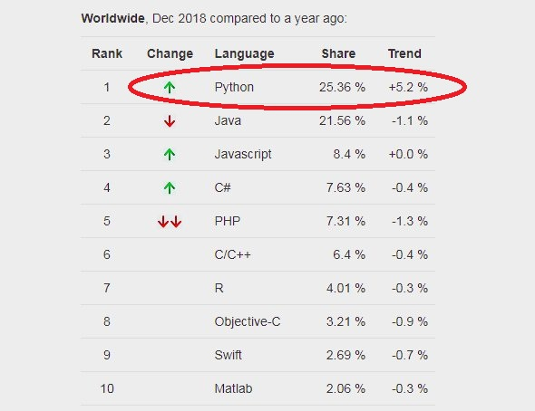
Why should I learn Python ?
3rd most popular programming
Fastest growing language
Opens lots of doors
Big corporates prefer Python
Means , PYTHON IS THE FUTURE

Slide 27
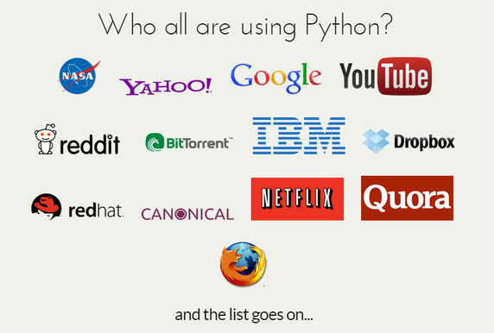
Who uses Python today ?

Slide 28
Features Of Python
Simple
Dynamically Typed
Robust
Supports multiple programming paradigms
Compiled as well as Interpreted
Cross Platform
Extensible
Huge Library

Slide 29
Simple
Python is very simple
As compared to other popular languages like Java and C++, it is easier to code in Python.
Python code is comparatively 3 to 5 times smaller than C/C++/Java code

Slide 30
Print Hello Bhopal!
IN C
#include <stdio.h>
int main(){
printf("Hello Bhopal!");
return 0;
}
IN JAVA
public class HelloWorld{
public static void main( String[] args ) {
System.out.println( "Hello Bhopal!" );
}
}
IN PYTHON
print('Hello Bhopal!')

Slide 31
Add 2 Nos
IN C
#include <stdio.h>
int main(){
int a=10,b=20;
printf(“Sum is %d”,a+b);
return 0;
}
IN JAVA
public class HelloWorld{
public static void main( String[] args ) {
int a=10,b=20;
System.out.println( “Sum is “+(a+b));
}
}
IN PYTHON
a,b=10,20;
print(“Sum is”,a+b)

Slide 32
Swap 2 Nos
IN C
int a=10,b=20,temp;
temp=a;
a=b;
b=temp;
IN JAVA
int a=10,b=20,temp;
temp=a;
a=b;
b=temp;
IN PYTHON
a,b=10,20
a,b=b,a

Slide 33
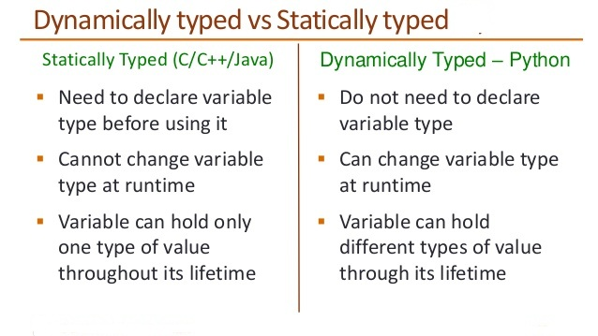
Dynamically Typed

Slide 34

Dynamically Typed
IN C
int a;
a=10;
a=“Bhopal”;
IN Python
a=10
a=“Bhopal”

Slide 35
Robust
Python has very strict rules which every program must
compulsorily follow and if these rules are violated then Python terminates the code by generating “Exception”
To understand Python’s robustness , guess the output of the
following C/C++ code:
int arr[5];
int i;
for(i=0;i<=9;i++)
{
arr[i]=i+1;
}

Slide 36
Robust
In Python if we write the same code then it will generate Exception terminating the code
Due to this other running programs on the computer do not get affected and the system remains safe and secure

Slide 37
Supports Multiple Programming Paradigms
Python supports both procedure-oriented and object-oriented programming which is one of the key features.
In procedure-oriented languages, the program is built around procedures or functions which are nothing but reusable pieces of programs.
In object-oriented languages, the program is built around objects which combine data and functionality

Slide 38
Compiled As Well As Interpreted
Python uses both a compiler as well as interpreter for converting our source and running it
However , the compilation part is hidden from the programmer ,so mostly people say it is an interpreted language

Slide 39
Cross Platform
Let’s assume we’ve written a Python code for our Windows machine.
Now, if we want to run it on a Mac, we don’t need to make changes to it for the same.
In other words, we can take one code and run it on any machine, there is no need to write different code for different machines.
This makes Python a cross platform language

Slide 40
Extensible
Python allows us to call C/C++/Java code from a Python code and thus we say it is an extensible language
We generally use this feature when we need a critical piece of code to run very fast .
So we can code that part of our program in C or C++ and then use it from our Python program.

Slide 41
Huge Library
The Python Standard Library is huge indeed.
It can help you do various things like Database Programming , E-mailing ,GUI Programming etc

Slide 42
Course Outline
We will be covering complete Core Python in this course:
Finally all this will be incorporated in a FREE PROJECT
Course Duration : Around 45 hours
Class Schedule: 6:30-7:30 PM on Tue,Thu,Sat
Module-1 | Module-2 | Module -3
Introduction | Functions | Introduction To OOP
Python 2 Vs Python 3 | Lambdas | Inheritance
Data Types | String | Exception Handling
Operators | List & Tuple | Database Programming
Control Statements | Dictionaries | File Handling
Modules | Comprehensions | GUI Programming

Slide 43
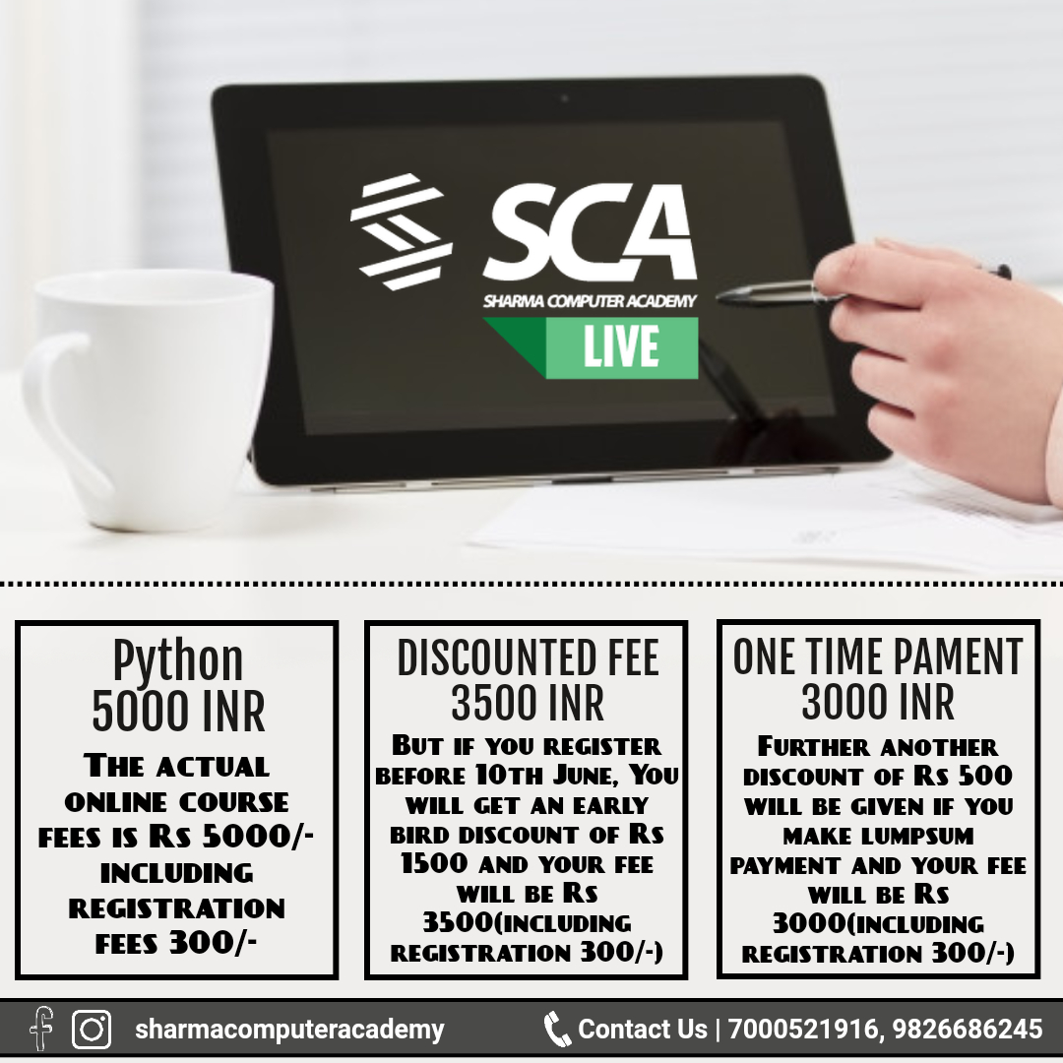
Course Fee

Slide 44
Next Class. . .
The next class is on Thursday , 28th May @ 6:30 PM
For any query ,please call at 9826086245,9826686245.

